Slide 2


Aarshad Devani Web, XR, C# Developer

Slide 3
What are we going to talk about ?

Slide 4
Web AR

Slide 5
But what in Web AR ?

Slide 6
Face Filters

Slide 7
But what are Face Filters ?

Slide 8
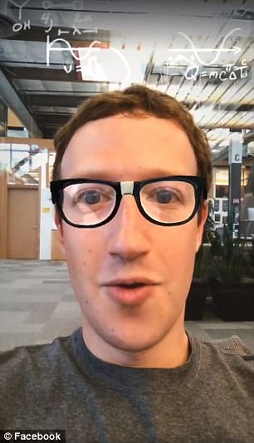
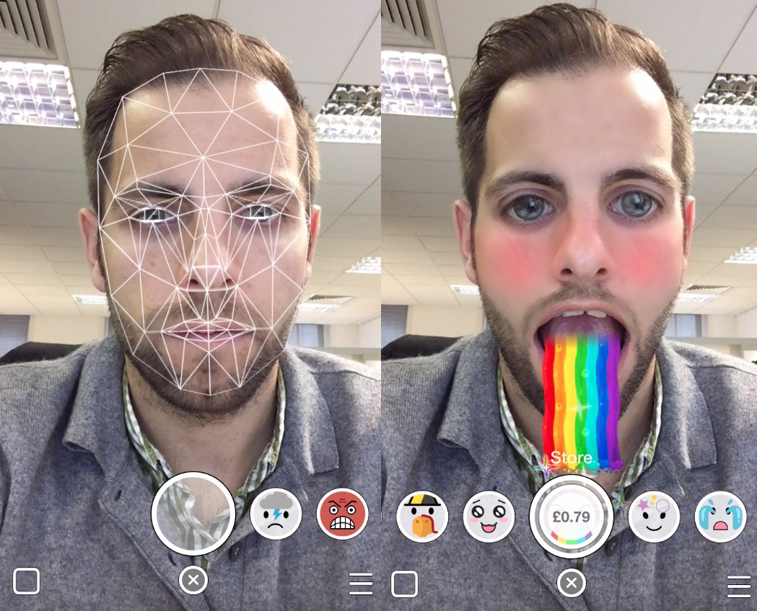
Face Filter Examples
Snapchat
Facebook

Slide 9
How are these built ?

Slide 10

OK but How??

Slide 11
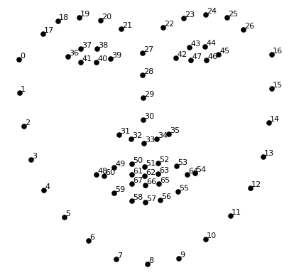
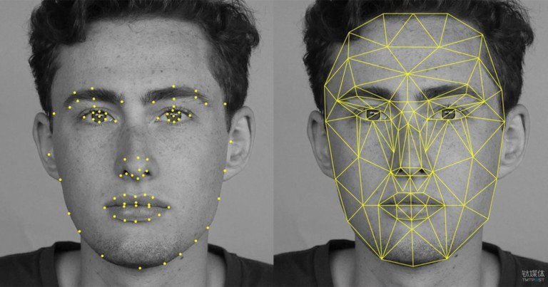

Slide 12

But what about such cases?

Slide 13

When are you going to tell us how to build our own filters ?

Slide 14
NO DEMO

Slide 15


Slide 16
DEMO

Slide 17


Slide 18
Questions ??

Slide 19
Questions ???

